Slide 1
Habytat Metaverse Secure Messaging My Family Museum
September 2023

Slide 2
Cautionary Statements
This presentation has been prepared by DatChat, Inc. (the “Company”) solely for informational purposes based on its own information, as well as information from public sources. This presentation has been prepared to assist interested parties in making their own evaluation of the Company and does not propose to contain all of the information that may be relevant. In all cases, interested parties should conduct their own investigation and analysis of the Company and the data set forth in the presentation and any other information provided by or on behalf of the Company. This presentation does not constitute an offer to sell, nor a solicitation of an offer to buy, any securities of the Company by any person in any jurisdiction in which it is unlawful for such person to make such an offering or solicitation. Neither the Securities and Exchange Commission nor any other regulatory body has approved or disapproved of the securities of the Company or passed upon the accuracy or adequacy of this presentation. Any representation to the contrary is a criminal offense.
Except as otherwise indicated, this presentation speaks as of the date hereof. The delivery of this presentation shall not, under any circumstances, create any implication that there has been no change in the affairs of the Company after the date hereof.
Certain of the information contained herein may be derived from information provided by industry sources. The Company believes that such information is accurate and that the sources from which it has been obtained are reliable. The Company cannot guarantee the accuracy of such information and has not independently verified such information.
This presentation contains forward-looking statements within the meaning of the federal securities laws. These forward-looking statements can be identified by the use of forward-looking terminology, including the terms “believe,” “estimate,” “project,” “anticipate,” “expect,” “seek,” “predict,” “continue,” “possible,” “intend,” “may,” “might,” “will,” “could,” would” or “should” or, in each case, their negative, or other variations or comparable terminology. These forward-looking statements include all matters that are not historical facts. They appear in a number of places throughout this presentation and include statements regarding our intentions, beliefs or current expectations concerning, among other things, our product candidates, clinical development pathway, research, commercialization objectives, prospects, strategies and the industry in which we operate. We derive many of our forward-looking statements from our operating budgets and forecasts, which are based upon many detailed assumptions. While we believe that our assumptions are reasonable, we caution that it is very difficult to predict the impact of known factors, and, of course, it is impossible for us to anticipate all factors that could affect our actual results. Forward-looking statements should not be read as a guarantee of future performance or results and may not be accurate indications of when such performance or results will be achieved. In light of these risks and uncertainties, the forward-looking events and circumstances discussed in this presentation may not occur and actual results could differ materially from those anticipated or implied in the forward-looking statements.
Nasdaq:DATS
2

Slide 3
About DatChat, Inc.
Nasdaq: DATS
20,195,367 Common Shares Outstanding
Habytat Mobile Metaverse
Artificial Intelligence Technology
7 Granted Patents
Proprietary Privacy and Social Media Technology
New Utility of the Metaverse
Nasdaq:DATS
3

Slide 4
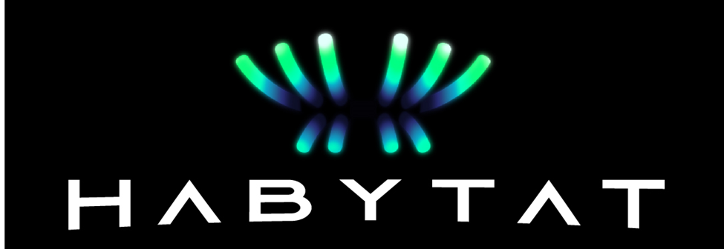
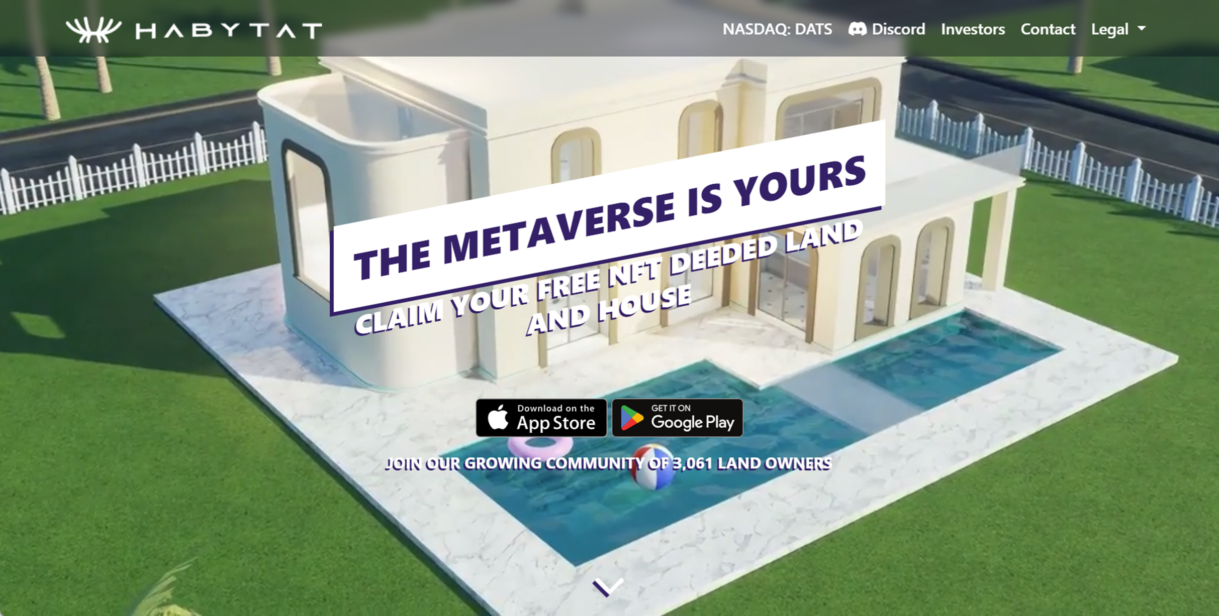
Positioned to be the Largest & Fastest Growing Metaverse in History
Free NFT Deeded Property and House,
Near Photo-Realistic, Mobile Access, Thing to Do such as Art Galleries, clubs and Pets
New Utilities that will make the Metaverse a daily part of our Lives
Proprietary AI Technology
Unique Growth Strategy to acquire and retain active users
4

Slide 5
Successfully Building the Metaverse
“We are a leading provider for protection and privacy through our social media technology ecosystem,”
Over 110,000 Active Landowners and Growing
Currently 50 Highly Qualified Engineers, 3D Designers and Managers Mostly located in Colombia.
Development Costs less than $120K per Month
AI Pets are driving Habytat User Adoption
Launching an Important New Utility for the Metaverse in 4th Quarter
5

Slide 6
AI Dogs Fueling User Adoption
You need to take care of, train and love your puppy that will grow into an adult.
As your puppy matures you can interact and compete with other pet owners at the Dog Park
NPC AI Engine helps your Pet become custom to each user. Eventually the Dogs will talk…if you want them to
Cats and Additional Breed Coming Soon
6

Slide 7
New Utility of the Metaverse
We have more Pictures and Media then ever before, but most of it is locked on our mobile devices and clouds
Changes the Ownership Dynamic of Data Ownership back to the User
Creates New Ways to Share, Save, Preserve, Control and Create a Legacy
3D Social Networking will provide users next gen social media experience
Patented Technology
Nasdaq:DATS
7

Slide 8
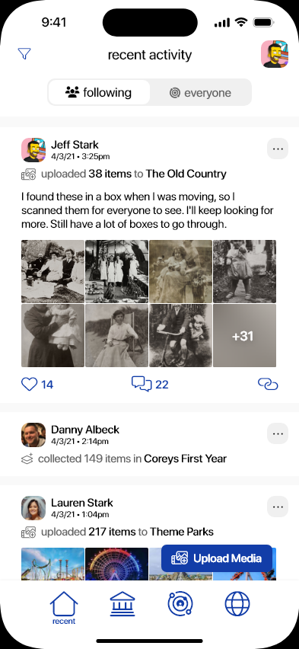
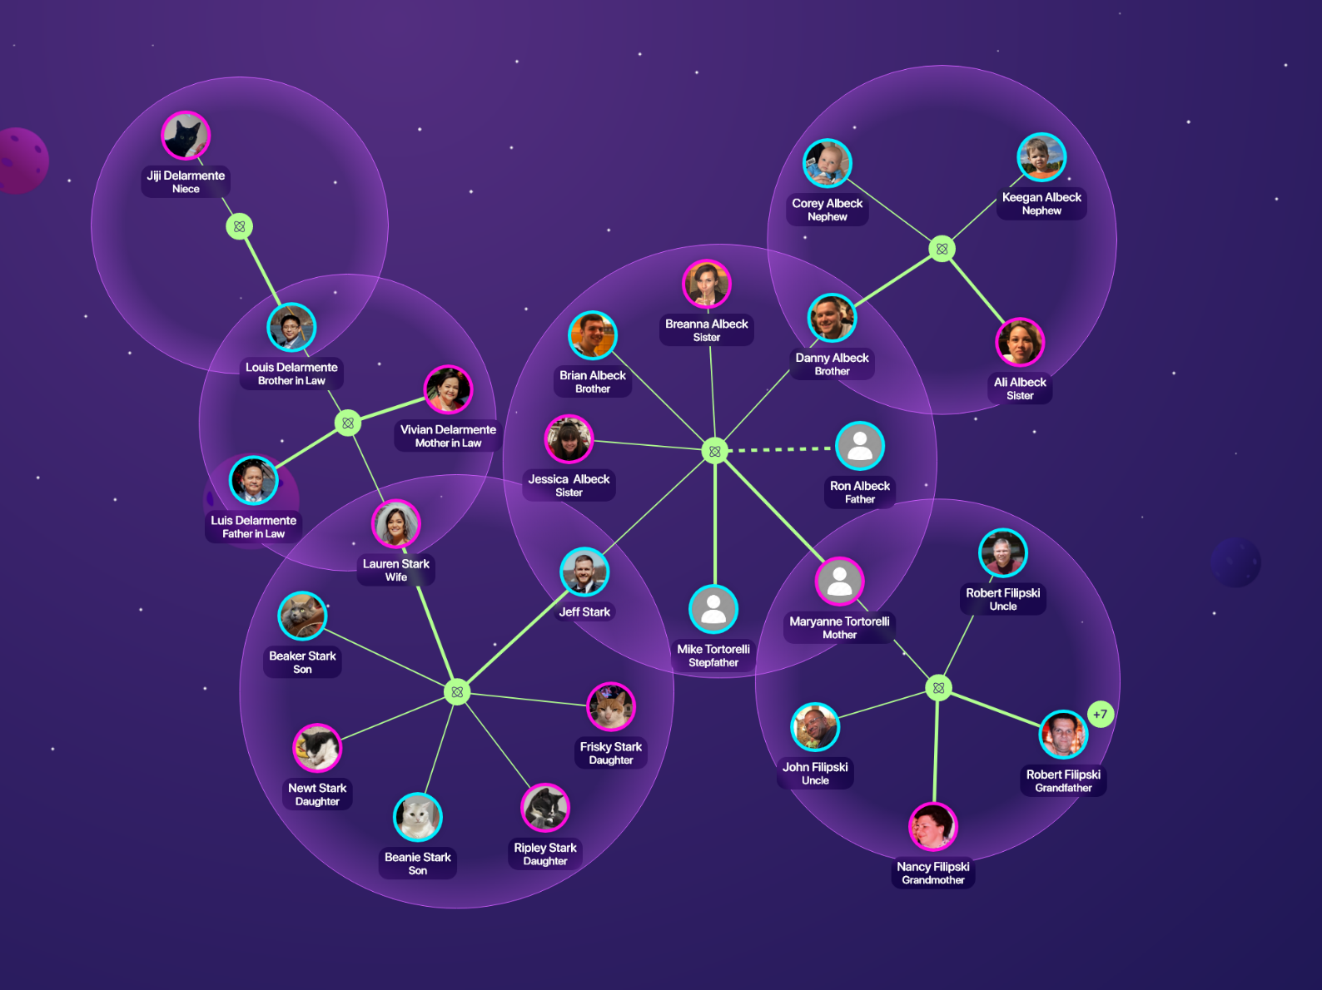
My Family Museum
Connecting Your Entire Extended Family Forever
8

Slide 9
Revenue Model:
AI Pets Create Premium Targeted Ad Inventory for the lucrative pet industry
Pet and Household Based Product Placements
Cloud Water is our First Advertising Partner
My Family Museum offers a Subscription and Ad Based Platform
Unique NPC Advertising
In-World Purchases
9

Slide 10
Competitive Advantages:
Early & First Mover Advantages
7 Granted Patents with Several more Pending
Do Not have to rely on NFT Sales or Crypto Currencies
Fast Growing Active User Base
Cost Effective & Fast Development Team
User Base Growing Over 2,000 New Users Per Day
10

Slide 11
Thank You.
Darin Myman, CEO
ir@datchats.com
800-658-8081
11

